Slide 1

World Markets in
Goods and Credit

Slide 2
World Markets in Goods and Credit
Law of one price
  Assume first that the goods produced in each country are physically identical.
  In addition, suppose that transport costs and barriers to trade across national borders are small enough to neglect.

Slide 3
World Markets in Goods and Credit
Law of one price
  The idea of this law is that markets work to ensure that the same goods sells at the same price for all buyers and sellers in all locations.
  We also simplify by ignoring inflation, so that the price level, P, is constant over time.
  i_{t} = i^{f}_{t ：} home = foreign nominal interest rate
  r_{t} = r^{f}_{t：} home = foreign real interest rate since inflation is zero.

Slide 4
The Balance of International Payments

Slide 5
The Balance of International Payments
If closed economy:
  Y_{t} = C_{t}+ I_{t}+ G_{t}
  real GDP = real domestic expenditure

Slide 6
The Balance of International Payments
If there is open economy:
  Let B^{f}_{t} be the net nominal holdings of foreign assets by the home country at the end of year t.
  These foreign assets could be held by the home country’s households or government.
  The addition to home country’s ownership of assets located in the rest of the world is called foreign direct investment （FDI: 对外直接投资) from home country to foreign country.

Slide 7
The Balance of International Payments
  Net real asset income from abroad: r_{t−1} ·B^{f}_{t−1}/P
  The total real income of domestic residents in year t is real GDP, Y_{t}, plus net real asset income from abroad, r_{t−1} · B^{f}_{t−1}/P
  This total is called the real gross national product (real GNP).
    Real GNP= Y_{t} + r_{t−1} ·B^{f}_{t−1}/P
  = real GDP
  + net real asset income from abroad

Slide 8
The Balance of International Payments
  real domestic expenditure + net foreign investment = real GNP on goods and services
    C_{t}+ I_{t}+ G_{t} +(B^{f}_{t} −B^{f}_{t−1})/P = Y_{t}+ r_{t−1}·B^{f}_{t−1}/P
    Where (B^{f}_{t} −B^{f}_{t−1})/P is called net foreign investment.

Slide 9
The Balance of International Payments
(B^{f}_{t}−B^{f}_{t−1})/P = Y_{t}+r_{t−1}·B^{f}_{t−1}/P − (C_{t}+I_{t}+G_{t})
  net foreign investment= real GNP − real domestic
  expenditure
  net foreign investment= real current account balance（经常性项目余额）
    If the current-account balance is greater than zero, the home country has a current-account surplus.
    If the balance is less than zero, the home country has a current-account deficit.
    If the balance equals zero, the home country has a balanced current account.

Slide 10
The Balance of International Payments
Trade Balance
  Exports are the goods and services produced in the home country sold to the rest of the world.
  Imports are the goods and services produced by the rest of the world bought by home country.
  The difference between exports and imports, or net exports, is called the trade balance.
    trade balance = Y_{t} − (C_{t}+ I_{t}+ G_{t}) =NX
    = real GDP− real domestic expenditure

Slide 11
The Balance of International Payments
Current account balance and Trade balance
  (B^{f}_{t}−B^{f}_{t−1})/P
= Y_{t}− (C_{t}+ I_{t}+ G_{t}) + r_{t−1}·B^{f}_{t−1}/P
  real current-account balance
= trade balance + net real asset income from
abroad

Slide 12
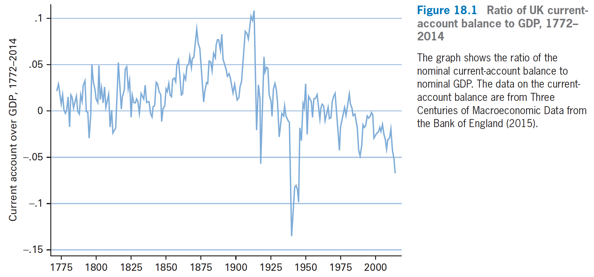
The Balance of International Payments

Slide 13
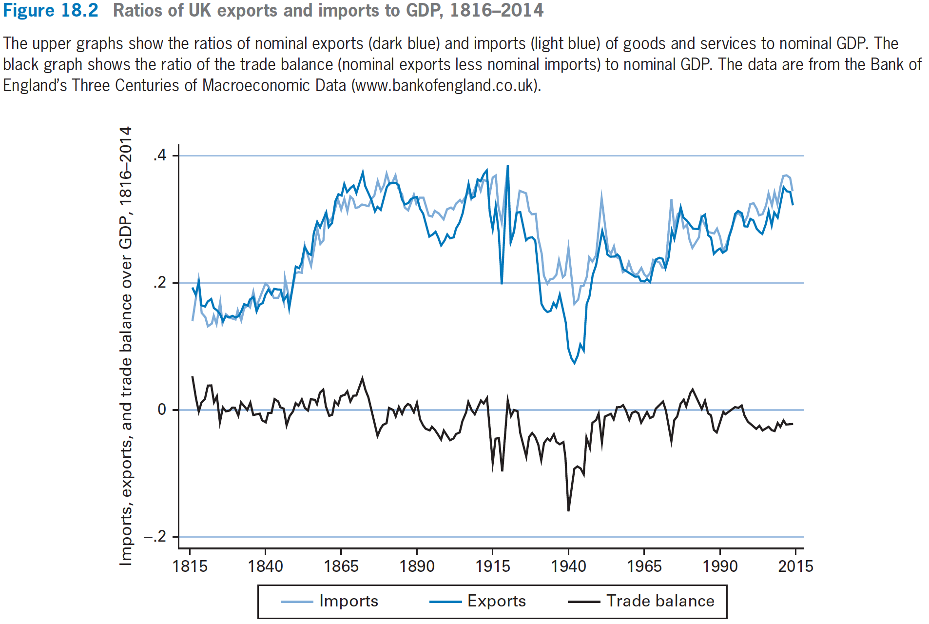
The Balance of International Payments

Slide 14
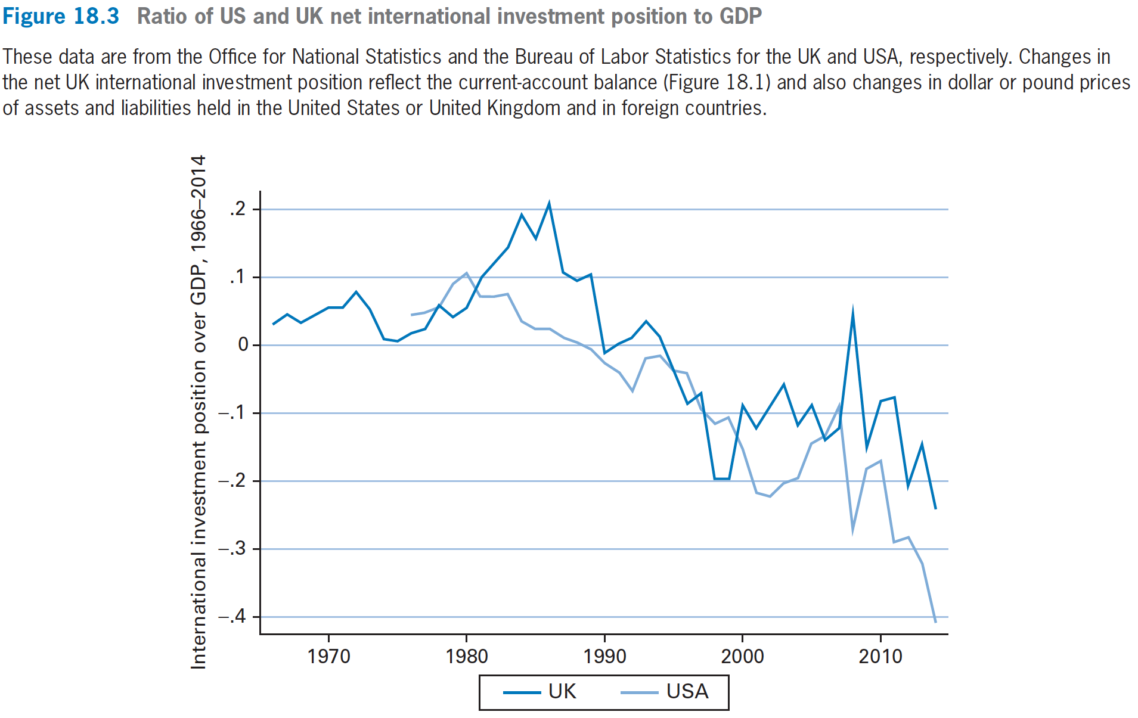
The Balance of International Payments

Slide 15
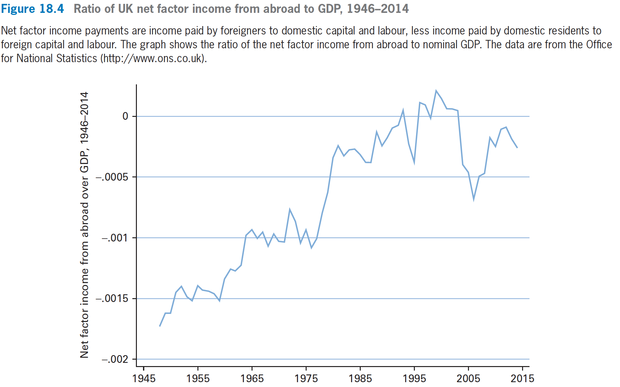
The Balance of International Payments

Slide 16
Determinants of the Current-Account Balance

Slide 17
Determinants of the Current-Account Balance
Current account balance:
  (B^{f}_{t}−B^{f}_{t−1})/P =Y_{t}+r_{t−1}·B^{f}_{t−1}/P − (C_{t}+I_{t}+G_{t})
  =Y_{t} − (C_{t}+I_{t}+G_{t}) +r_{t−1}·B^{f}_{t−1}/P
Production Function: Y_{t} = A· F(K_{t}, L_{t})
Total Expenditures in a closed economy:
  C_{t}+ I_{t}+ G_{t}
The real interest rate on bonds, r_{t}, has to equal the real rate of return on capital, that is,
  r_{t} = MPK− δ

Slide 18
Determinants of the Current-Account Balance
Suppose, to begin, the real interest rate in the rest of the world, r^{f}, is constant and happens to equal the domestic real interest, r_{t}, that is, r_{t} = r^{f}.
The opening up to the world credit market would not change the real interest rate available to the home country’s households.

Slide 19
Determinants of the Current-Account Balance
The home country would end up with the same real GDP, Y_{t}, consumption, C_{t}, gross domestic investment, I_{t}, and so on.
Therefore, the condition Y_{t} = C_{t} + I_{t} + G_{t} would continue to hold.
We see, accordingly, that the trade balance :
Y_{t} – (C_{t} + I_{t} + G_{t} ) = 0.

Slide 20
Determinants of the Current-Account Balance
The real current-account balance:
  (B^{f}_{t} − B^{f}_{t−1})/P = Y_{t}− ( C_{t}+ I_{t}+ G_{t}) + r_{t−1}·B^{f}_{t−1}/P
Since the home country had initially been closed, it must have started with a zero net international investment position, B^{f}_{t−1} = 0, therefore, the net real asset income from abroad is zero.
Since the trade balance is also zero, we have that the current-account balance is zero.

Slide 21
Determinants of the Current-Account Balance
Effects of increase in the technology level, A.
  (B^{f}_{t} − B^{f}_{t−1})/P = Y_{t}− (C_{t}+ I_{t}+ G_{t}) + r_{t−1}·B^{f}_{t−1}/P
  the net real asset income, r_{t−1}·(B^{f}_{t−1}/P), is given, for example, at zero, if the home country starts with a zero net international investment position, B^{f}_{t−1}/P=0.
  real government purchases, G_{t}, are also given.

Slide 22
Determinants of the Current-Account Balance
If change in A is permanent:
  C_{t} will rise by roughly as much as Y_{t}, so Y_{t}-C_{t} does not change (假设 r 提升引起的跨期替代效应很小）.
  Higher A raises MPK, and thereby increases gross domestic investment, I_{t}. The current-account balance falls overall because of the increase in I_{t}.
  So, the current account balance tends to move toward deficit（减少国外投资，增加国内投资）.

Slide 23
Determinants of the Current-Account Balance
Effect of Saving and Investment
  B^{f}_{t} − B^{f}_{t−1}/P = [Y_{t}+ r_{t−1}·B^{f}_{t−1}/P − δ K_{t−1} − (C_{t}+G_{t})]
  − (I_{t}− δ K _{t−1})
  real current-account balance
  = real national saving − net domestic investment

Slide 24
Determinants of the Current-Account Balance
Opening up of home country to the world credit market
  Suppose the real interest rate, r_{t}, that would prevail in home country if it were closed, is less than the rate in the rest of the world, r^{f}, home country lends to the rest of the world and has lower net domestic investment, I_{t}−δK_{t−1}.
  The home country has a current-account surplus

Slide 25
Determinants of the Current-Account Balance
  If the real interest rate, r_{t}, that would prevail in home country if it were closed, is greater than the rate in the rest of the world, r^{f} , the result is opposite. Home country borrows from the rest of the world to pay for higher net domestic investment, I_{t}−δK_{t−1}.
  In this case, opening up of home country to the world credit market results in current-account deficit.

Slide 26
Determinants of the Current-Account Balance
  If the real interest rate, r_{t}, that would prevail in the home country if it were closed, happens to equal the rate in the rest of the world, r^{f}, which does not affect I_{t}−δK_{t−1}.
  In this case, the opening up to the rest of the world is of no effect, and the current account is still balanced.

Slide 27
Determinants of the Current-Account Balance
Economic Fluctuations
  Technology A raises MPK, and thereby increases investment, I_{t}, as well as I_{t} − δK_{t−1}.
  If increase in A is less than fully permanent, C_{t} rises by less than the increase in real GDP, Y_{t} , Therefore, real national saving increases.
  The overall change in real current-account balance depends on whether I_{t} − δK_{t−1} rises by more or less than real national saving.

Slide 28
Determinants of the Current-Account Balance
  In general, the overall effect on the real current-account balance is ambiguous.
  The equilibrium business-cycle model predicts that the real current account balance will be countercyclical - low in booms and high in recessions.
  本国经济繁荣的时候，国内投资实际收益率上升，国内投资增长，对外投资减少，造成real current account balance 下降.

Slide 29
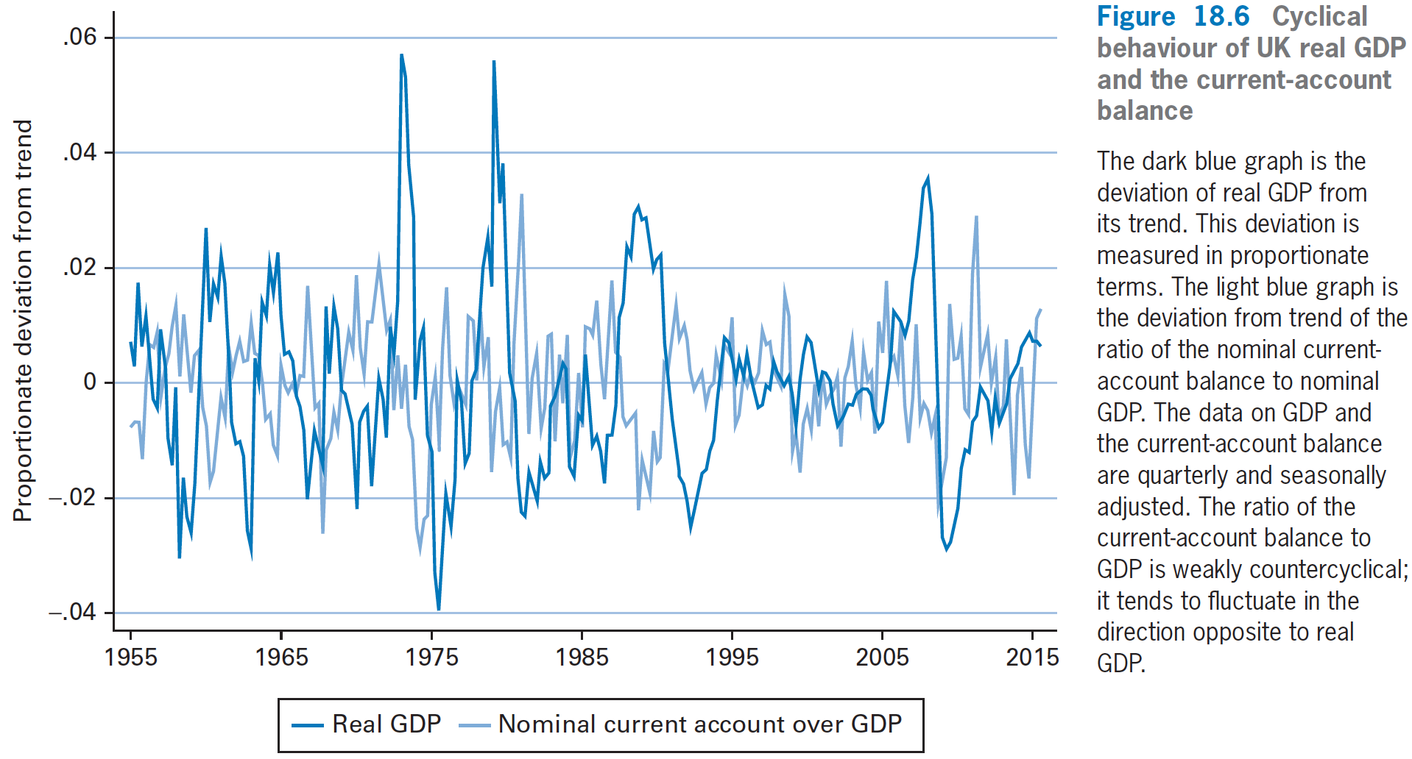
Determinants of the Current-Account Balance
经常性账户余额逆周期

Slide 30
Determinants of the Current-Account Balance
Harvest Failures and Developing Countries
  Harvest failure
    results in a drop of home country’s real GDP, Y_{t}.
    If the harvest failure is expected to be temporary, the income effect is weak, and the response of consumption, C_{t}, is small.
    Therefore, Y_{t} − C_{t} falls sharply.
    Home country’s real national saving decreases almost one-to-one with the decline in Y_{t}.

Slide 31
Determinants of the Current-Account Balance
  Although the harvest failure means less real GDP this year, there may be little impact on the MPK. In this case, there would be little response of net domestic investment, I_{t} − δK_{t−1}.
  Harvest failure leads to current-account deficit. The home country borrows from abroad to maintain roughly stable consumption, C_{t}, and net domestic investment, I_{t} − δK_{t−1}.
  In this case, a current-account deficit is a symptom of bad economic times.

Slide 32
Determinants of the Current-Account Balance
How current-account balance lines up with a country’s long-term growth potential.
  Suppose home country is a developing country with a low capital stock, K_{t−1}, and a high MPK, so net domestic investment, I_{t} − δK_{t−1} tends to be high.
  In these cases, a current-account deficit tends to be a sign of a favorable growth environment, whereas a current-account surplus is a sign of an unfavorable environment.

Slide 33
Determinants of the Current-Account Balance
Effect of the Budget Deficit
  The real current-account balance is given by
  B^{f}_{t} − B^{f}_{t−1}/P = Y_{t}+ r_{t−1}·B^{f}_{t−1}/P − δ K_{t−1} − (C_{t}+G_{t})
  − ( I_{t}−δ K _{t−1})
  If in the Ricardian(李嘉图等价定理), where households save the full amount of tax cut because they know government is going to raise the tax more in the next year.
  A budget deficit does not change real national saving and real net investment, so a budget deficit does not create a current-account deficit.

Slide 34
Determinants of the Current-Account Balance
However, conclusions are different if households do not save the full amount of the tax cut.
That is, consumption, C_{t}, rises, and real national saving declines.
A budget deficit leads to a current-account deficit.

Slide 35
Determinants of the Current-Account Balance
When budget deficit and current-account deficit occur at the same time, an economy is said to be suffering from twin deficits.
E.g: economists applied this label to the US economy in the mid-1980s, when budget deficits were large and the ratio of the current-account deficit to GDP gradually widened.

